Slide 1
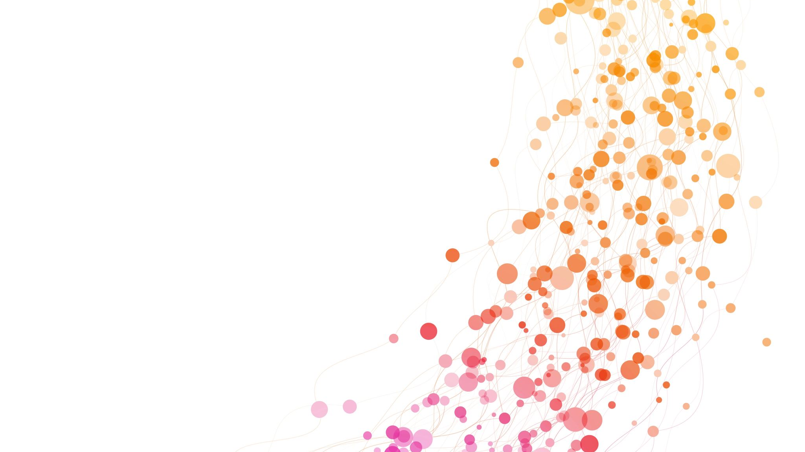
Dragon Quest III Team building
A team must be chosen for a new Game in Dragon Quest III

Slide 2
Problem
Challenge:
Team selection is a common "hard stop" for both new and experienced players.
Players face difficulty due to limited information and overwhelming choices during the selection process.
Our Solution:
Smiling Slime Inc. simplifies team-building to enhance gameplay enjoyment.
Leverages 15+ years of expertise to identify key data points for optimal team compositions.
Key Benefits:
Removes pain points in party creation.
Supports diverse playstyles:
Efficiency: Build the strongest, most effective team.
Fun: Experiment with unique character combinations.
Challenges: Craft unconventional, antithetical builds.
Our Goal: To empower players to make informed, enjoyable decisions, transforming a barrier into a seamless and engaging experience.

Slide 3
Requirements
Team Creation and Composition
1. Objective:
Create a party of three unique characters in Dragon Quest III using the character creation menu.
2. Character Uniqueness:
Distinct Classes: Each character must belong to a unique class (e.g., Warrior, Mage, Priest, Thief).
No Duplication: No two characters can share the same class.
3. Minimum Team Requirements:
Melee-Focused Character: At least one Warrior, Fighter, or Thief.
Magic-Using Character: At least one Priest or Mage.
4. Character Creation Process:
Standard Steps:
Choose a name.
Allocate stats (Strength, Agility, Intelligence, etc.).
Select a class, ensuring no duplication.
Consistency: The process is uniform for all characters.

Slide 4
Requirements cont.
Guidelines, Flexibility, and Validation
5. General Guidelines:
Minimum Roles:
At least one melee class: Warrior, Fighter, Thief.
At least one magic class: Priest, Mage.
No Duplicate Roles: No two characters can have the same class.
6. Flexibility in Customization:
Names: Fully customizable.
Stats: Flexible allocation within game mechanics.
7. Verification and Validation:
Completion Criteria:
Exactly three characters.
Unique classes.
At least one melee and one magic class.
Error Handling:
Violations trigger system notifications.
Team cannot be finalized until all criteria are met.

Slide 5
Alternatives: 1
Team #1: Warrior, Priest, Mage (Optimal Early and Late Game)
Objective: Balanced team for offense, defense, and strategic growth.
Composition:
Ragnar (Warrior)
Personality: Daredevil | Focus: Resilience, Agility
Rationale: Male chosen for late-game stat growth.
Kass (Priest)
Personality: Contrarian | Focus: Agility, Resilience, Luck
Rationale: Female for gender-locked gear; durable healer.
Brin (Mage)
Personality: Genius | Focus: Agility, Wisdom
Rationale: Female for spellcasting efficiency and mana growth.
Strengths: Strong early-game survivability and late-game scaling.

Slide 6
Alternatives: 2
Team #2: Fighter, Priest, Merchant (Balanced Early, Challenging Late Game)
Objective: Easy early game with offense-defense balance; more difficult late game.
Composition:
Oio (Fighter)
Personality: Show-Off | Focus: Strength, Agility
Rationale: Female for late-game armor; high-speed melee attacker.
Thad (Priest)
Personality: Ironman | Focus: Resilience
Rationale: Male for tank growth and support durability.
Gold (Merchant)
Personality: Amazon | Focus: Strength
Rationale: Male for strength optimization; temporary member for early-game ease.
Strengths: Excellent early-game performance; balanced roles.

Slide 7
Alternatives: 3
Team #3: Thief, Mage, Jester (Fun Team, Hard Difficulty)
Objective: Unique, challenging gameplay with unconventional roles.
Composition:
Karl (Thief)
Personality: Quick | Focus: Agility
Rationale: Male for speed-focused thieving and attacks.
Cast (Mage)
Personality: Lucky Devil | Focus: Resilience, Luck
Rationale: Male for mage durability and status resistance.
Bonk (Jester)
Personality: Paragon | Focus: Melee damage (Sage transition planned)
Rationale: Female for Sage class compatibility; physical presence pre-transition.
Strengths: Encourages creative strategies and unique playstyles.

Slide 8
Requirements and Alternatives
Project Requirements Recap
Party Creation: Each team must be built from scratch using the character creation menu.
Unique Classes: No duplicate characters; each class must be distinct.
Melee-Focused Character: At least one Warrior, Fighter, or Thief is required.
Consistent Creation Process: All characters follow the same steps (name, stats, class, personality).
Magic-Class Character: At least one character must belong to a magic class (Priest or Mage).

Slide 9
Requirements and alternatives cont.
Team #1: Warrior, Priest, Mage (Optimal Early and Late Game)
Composition:
Ragnar (Warrior): Melee-focused, resilient, and agile (Daredevil personality).
Kass (Priest): Durable healer with agility and resilience (Contrarian personality).
Brin (Mage): Spellcasting specialist with high wisdom (Genius personality).
How It Meets Requirements:
Unique characters with no duplication.
Warrior as the melee role; Priest and Mage as magic roles.
Consistent creation process across all members.
Strengths: Balanced for both offense and defense, scaling well into late-game.

Slide 10
Requirements and alternatives cont.
Team #2: Fighter, Priest, Merchant (Balanced Early, Challenging Late)
Composition:
Oio (Fighter): High-damage melee attacker with agility (Show-Off personality).
Thad (Priest): Resilient healer and tank (Ironman personality).
Gold (Merchant): Early-game utility, swapped for another role late-game (Amazon personality).
How It Meets Requirements:
No duplicate classes.
Fighter as melee role; Priest as magic role.
Consistent creation process for all characters.
Strengths: Easy early game with a balanced offense and defense. Challenges increase in late-game.

Slide 11
Requirements and alternatives cont.
Team #2: Fighter, Priest, Merchant (Balanced Early, Challenging Late)
Composition:
Oio (Fighter): High-damage melee attacker with agility (Show-Off personality).
Thad (Priest): Resilient healer and tank (Ironman personality).
Gold (Merchant): Early-game utility, swapped for another role late-game (Amazon personality).
How It Meets Requirements:
No duplicate classes.
Fighter as melee role; Priest as magic role.
Consistent creation process for all characters.
Strengths: Easy early game with a balanced offense and defense. Challenges increase in late-game.

Slide 12
Requirements and alternatives fin.
Summary: All three teams meet project requirements, providing varied gameplay experiences tailored to different player goals and challenges.

Slide 13
Recommendation: Team 1
Why Choose Team #1?
Balanced Gameplay: Offers a strong combination of melee power, healing support, and magical offense.
Early and Late Game Viability: Excels in the early game and scales effectively into the late game.
Adaptability: Versatile enough for a variety of strategies, making it suitable for both new and experienced players.
Team Composition:
Ragnar (Warrior):
Melee-focused tank with high resilience and agility (Daredevil personality).
Kass (Priest):
Durable healer with excellent support abilities (Contrarian personality).
Brin (Mage):
High-damage spellcaster with optimized wisdom and agility (Genius personality).
Key Strengths:
Survivability: Strong defense and healing ensure longevity in battles.
Damage Output: Combines physical and magical offense for a well-rounded approach.
Ease of Use: Ideal for players seeking a reliable and efficient team without sacrificing versatility.
Recommendation: Team #1 is the optimal choice for achieving both short-term success and long-term dominance in Dragon Quest III.

